Slide 1
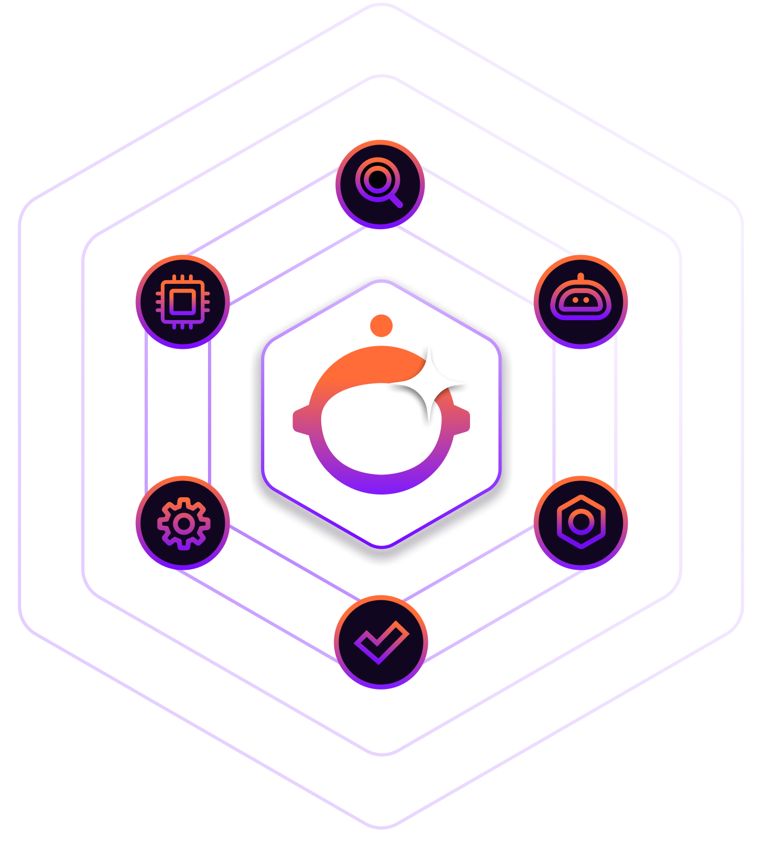

Building Agentic Workflows with MCP
Sterling Chin
Senior Developer Advocate
Notes:
Intro to Sterling

Slide 2
Thinking
Agentically
Notes:
Let's talk about what it means to think agentically. I would argue that most of us approach AI like this [CLICK]

Slide 3

Thinking Agentically
“Call the weather API with zip code 10001”
“Format this JSON response into a table”
“If the status is pending, wait 5 seconds and retry”
AI as a smart function caller
Notes:
[CLICK] 'Call the weather API with zip code 10001'
[CLICK] 'Format this JSON response into a table'
[CLICK] 'If the status is pending, wait 5 seconds and retry'
[CLICK] That's not agentic thinking. That's using AI as a smart function caller. We're micromanaging every decision.
Agentic thinking sounds like this: [CLICK]

Slide 4
Thinking Agentically
“Call the weather API with zip code 10001”
“Format this JSON response into a table”
“If the status is pending, wait 5 seconds and retry”
AI as a smart function caller
“Get me the weather for my meeting tomorrow”
“Keep the team updated on deployment status”
“Help me stay on top of my commitments”
Define goals, not procedures
Notes:
[CLICK] 'Get me the weather for my meeting tomorrow'
[CLICK] 'Keep the team updated on deployment status'
[CLICK] 'Help me stay on top of my commitments'
[CLICK] The difference? We're defining goals, not procedures.

Slide 5
Thinking Agentically
Agentic thinking is giving AI the ability to
make decisions for a given task, and giving it tools necessary to complete the task.
Notes:
The AI decides:
Which API to call
How to handle errors
What information matters
When to take action
We define the goal. The agent makes the decisions to achieve it.
Agentic thinking is giving the AI the ability to make decisions for a given task, and giving it the tools necessary to complete the task.

Slide 6
Demo
Slack to Jira in Flows
Notes:
Let me show you what I mean when I talk about agentic. To add some context to our first major agentic workflow:
When an issue is brought up on a feature that our team was building, a lot of the discussion was happening in slack. The PM would have to take the context and create a jira ticket with associated screenshots that he’d have to download from slack. That’s a lot of time taken by the PM to rehash everything. So we decided to take matters into our own hands. I’m going to show you Flows, but this can be done in other products as well, or written in code. The premise is that we made it easier to handle bugs! Let’s dig in.

Slide 7
Slack to Jira: Why this worked
Clear Goal
Available Capabilities
Freedom to decide
Notes:
Why did this work?
"Three things made this possible:
There was a clear goal, which is to turn conversations into trackable items
We also gave our AI access to all the available capabilities. The ability to read messages, analyze text, and create tickets
We gave the LLM the freedom to decide. The agent chooses how to achieve the goal, not us.
But the challenge is that we had to build all the API integrations manually. Every retry logic, every error handler, every auth flow.
What if we didn't have to?

Slide 8
Model Context Protocol
MCP: Making Agentic AI Practical
Notes:
Enter Model Context Protocol

Slide 9
Setting the Stage
Audience Poll
Notes:
Before we dive in, I want to get a sense of the room.
Raise your hand if this is the first time you’ve heard of Model Context Protocol or MCP?
Now, raise your hand if you’ve used MCP - whether building your own server or using someone else's?
Ok, so let’s talk about what MCP is and why it’s gained widespread adoption. But first, a brief history lesson.

Slide 10
Model Context Protocol
The history of MCP
Introduced by Anthropic Nov. 2024
3 Capabilities:
Tools (API/Function calls)
Prompts (custom prompts)
Resources (static information)
Notes:
MCP was introduced by Anthropic in Nov. of last year.
It has 3 capabilities: tools, prompts, and resources
Discuss the capabilities.
So why did it gain widespread adoption?

Slide 11
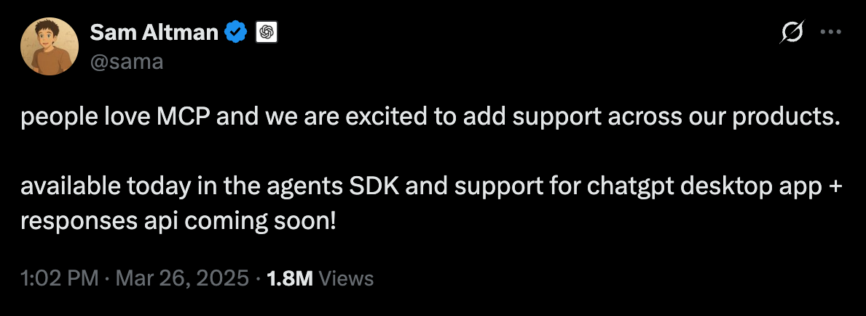
Model Context Protocol
Notes:
In March, Sam Altman posted on X that OpenAI would be adoption MCP.

Slide 12
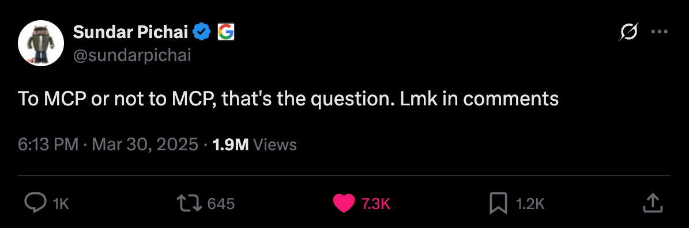
Model Context Protocol
Notes:
4 days later, Sundar Pichai, the CEO of google posed the question on X “to mcp or not to mcp, that’s the question”

Slide 13
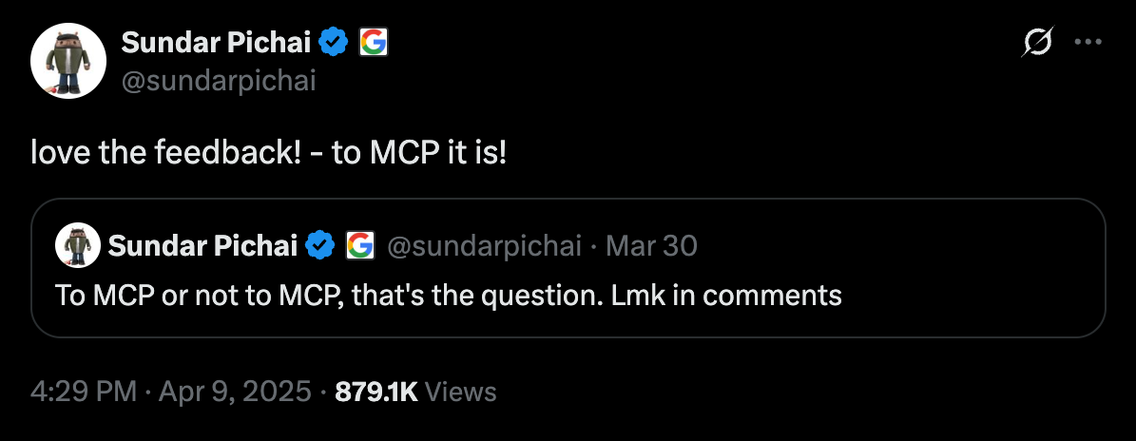
Model Context Protocol
Notes:
A little over a week later, Sundar Pichai confirmed that Google would be adopting MCP.
From that point on, MCP was off to the races.

Slide 14
Demo
Google Calendar MCP with Claude
Notes:
So I want to show you a quick demo of a simple MCP server that I built. This server give Claude access to my google calendar.

Slide 15
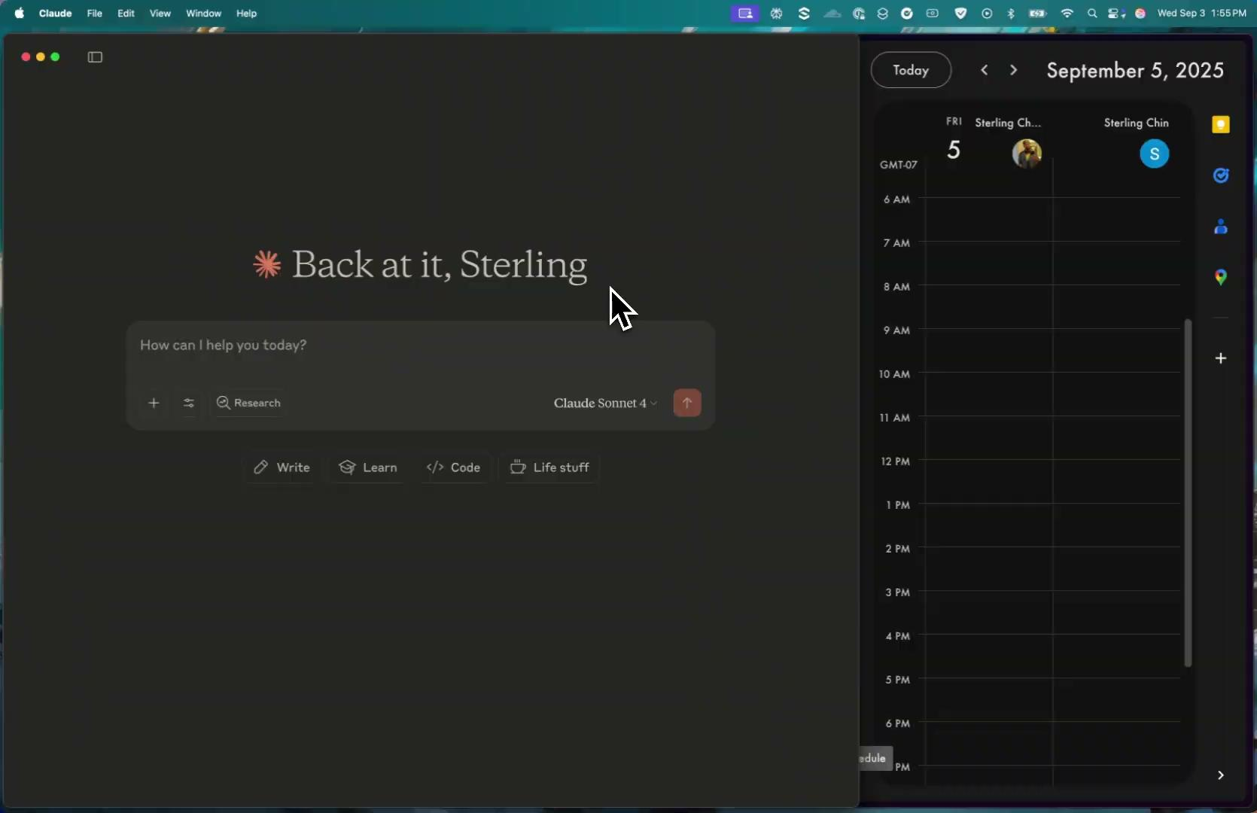

Slide 16
Build it and they will come!
Let’s Build an MCP Server
Notes:
The tools exist that give us the ability to build MCP servers with only a few clicks. Because I work at Postman, I’ll show you what we built, but there are so many other tools on the market.

Slide 17
Demo
Build an MCP server

Slide 18
I need help!
Using Claude Code as a Personal Assistant
Notes:
Now let’s take this even a step further. I’m a developer, so I’ve used claude code to help me write code, but I’ve also started using it as my personal assistant.

Slide 19
Demo
Claude Code Personal Assistant

Slide 20
Power Move
Ship once.
Adapt your APIs forever.
Notes:
We’ve seen MCP in action. Let me show you how to take it to the next level.

Slide 21
Demo
News MCP Server
Notes:
Preface for this demo, I’ve shipped an MCP server with a single tool, get the latest news. But I’m using Flows to dynamically update the mcp server without shipping it again.

Slide 22
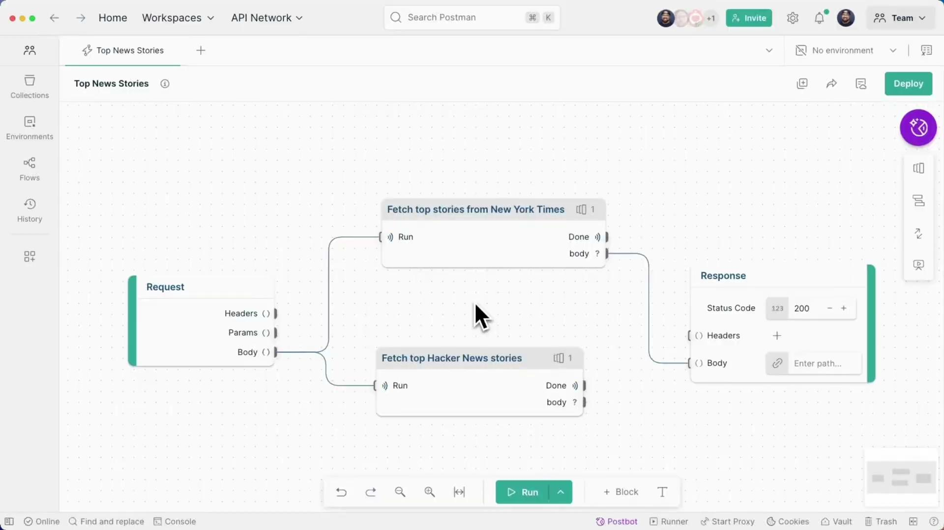

Slide 23
Here’s your guide
The Practical Path Forward
Notes:
"Here's how to start thinking and building agentically:

Slide 24
Here’s your guide
Step 1: Identify Agentic Opportunities
Look for goals, not tasks
'Keep customers informed' not 'send weekly email'
'Ensure compliance' not 'check these 5 things'
Notes:
Step 1: Identify Agentic Opportunities
Look for goals, not tasks
'Keep customers informed' not 'send weekly email'
'Ensure compliance' not 'check these 5 things'

Slide 25
Here’s your guide
Step 2: Map Your Capabilities
What APIs do you have?
What can they enable an agent to do?
Notes:
Step 2: Map Your Capabilities
What APIs do you have?
What can they enable an agent to do?

Slide 26
Here’s your guide
Step 3: Build One Agentic Workflow
Start simple: 2-3 capabilities
Clear success criteria
Let the agent figure out the 'how'
Notes:
Step 3: Build One Agentic Workflow
Start simple: 2-3 capabilities
Clear success criteria
Let the agent figure out the 'how'

Slide 27
Here’s your guide
Step 4: Expand and Learn
Add capabilities
Watch how agents use them
Notes:
Step 4: Expand and Learn
Add capabilities
Watch how agents use them

Slide 28
The Future
The future is agentic
Notes:
"Start here:
Pick one workflow. Ask 'what's the goal here?
Next, build an MCP server for one API - public or private
Let an agent use it. Watch what happens.

Slide 29
The Future
The future is agentic
Notes:
The future is agentic.
The tools are free. The SDKs are open source. Claude Code and Cursor are ready to help you build.
Stop thinking about APIs as endpoints to call.
Start thinking about them as capabilities to enable.
Stop programming every step.
Start defining what success looks like.
That's thinking agentically.

Slide 30



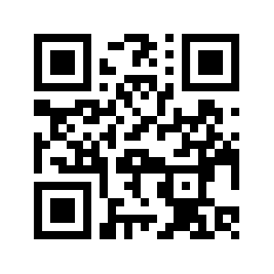


@SilverJaw82
www.sterlingchin.com

